Slide 1

Bahria University
Discovering Knowledge
Smart Ticketing System
Railway Based Ticketing System
Muhammad Hasan
Muhammad Arham
Muhammad Murtaza Khan
02-135251-040
02-135251-016
02-135251-018

Slide 2
Content:
What This Project Does
Code Structure Overview
Booking Logic
Code Example – Input Validation
Cancellation Logic
File Handling
Admin Features
What Makes This Project Strong
Conclusion

Slide 3
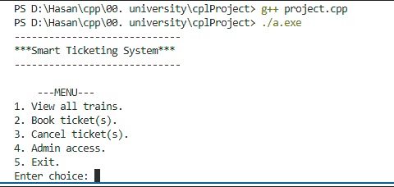
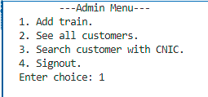
What This Project Does
Allows users to book, cancel, and view train tickets
Admin can manage train records & view customers
Saves all data to files
Includes input validation
Fully menu-driven + modular code

Slide 4
Code Structure Overview
main() contains the access control.
Code is split into 13 user-defined functions for:
Booking
Cancelling
Admin features
Validation

Slide 5
Booking Logic
User enters CNIC → validated + checked for uniqueness
Chooses Train ID → validated + checks availability
Inputs seat count → compared with available seats
Confirms payment
Data written to file and train seats are updated
Key function: addCustomer()

Slide 6
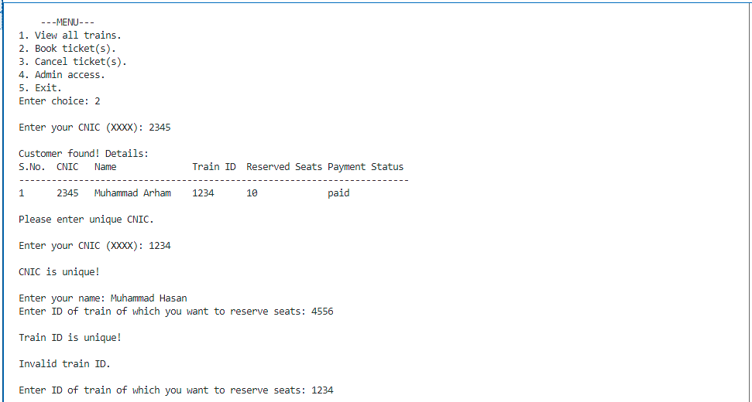
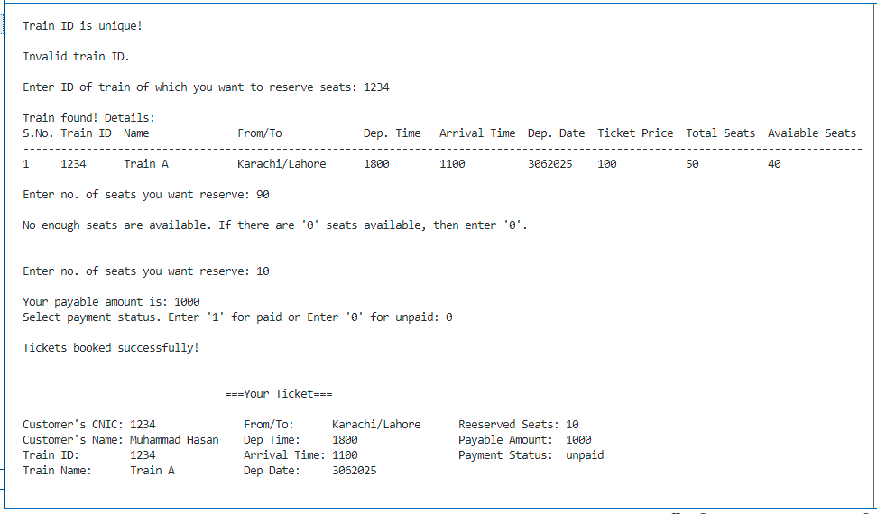

Slide 7
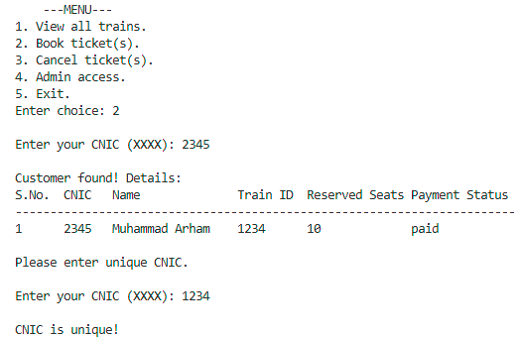

Code Example – Input Validation:
void getValidInt(string prompt, int &var){
cout << prompt;
cin >> var;
while(cin.fail()){
cout <<"Inavalid input! Try again..."<<endl;
cin.clear();
cin.ignore(1000, '\n');
cout << prompt;
cin >> var;
}
}

Slide 8
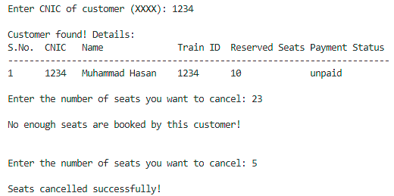
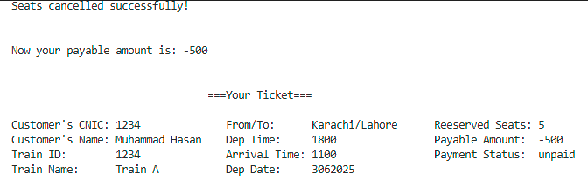
Cancellation Logic
CNIC is searched and customer data is retrieved
Train data is loaded & matched
User enters seats to cancel
Seat count and file data are updated
New ticket summary is shown with updated
price
Key function: cancelTicket()

Slide 9
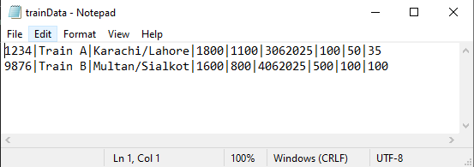
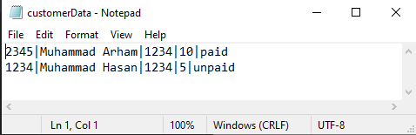
File Handling
All customer data stored in `customerData.txt`
All train data stored in `trainData.txt`
Temp files are used to update content safely
✔ No database, no crash risk

Slide 10
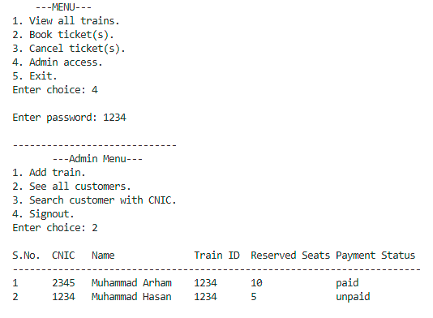
Admin Features
Protected by password (3 attempts only)
Admin can:
Add trains
View all customers
Search customer by CNIC

Slide 11
What Makes This Project Strong
No crash input validation
Fully file-based
Admin vs User access separation
All code uses basic concepts only

Slide 12
Conclusion
We built this project to apply all C++ topics that we learned
from conditional logic to file handling to modular design.
It simulates real-world ticketing while being 100% console based.

Slide 13
Questions?

Slide 14
Thank You ☺

